Slide 1
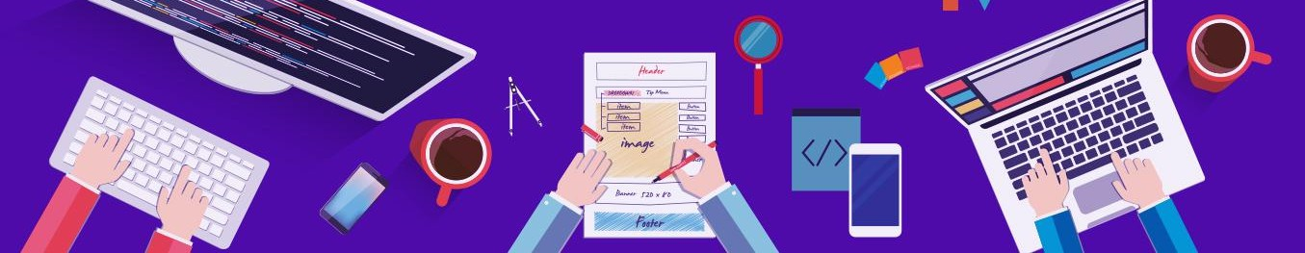




Introduction to Robotic Process Automation
THE INTELLIGENT SCREEN TIME MONITORING BOT FOR LAPTOPS
Your Register No:2116220701015 Name:AGILA SHREE A
Guide Name:Mrs. J.JINU SOPHIA
Designation:Assistant Professor(SG)
Department:Computer Science & Engineering

Slide 2
Abstract
"The Intelligent Screentime Monitoring Bot for laptops” is an innovative Robotic Process Automation (RPA) solution designed to promote digital well-being and productivity. Developed on the UiPath platform, this bot automates the tracking of application usage on laptops over a designated period. By utilizing Python scripting integrated with UiPath workflows, the bot monitors active windows, records screen time for each application, and compiles the data into a detailed Excel report. This report is then automatically emailed to the user for easy access and review. By offering an efficient, automated solution, this bot helps users optimize their screen usage and make more informed decisions about their digital habits, ultimately fostering healthier interactions with technology.

Slide 3
Need for the Proposed System
Existing screentime tracking methods rely on manual effort or basic third-party tools that lack accuracy, automation, and detailed insights.
The Intelligent Screentime Monitoring Bot automates the process of tracking application usage, reducing manual intervention.
It generates comprehensive reports in Excel format with app-specific usage data.
The bot seamlessly delivers reports via email for convenient access.
It enhances data precision and usability, empowering users to monitor their digital habits effortlessly.
The solution provides actionable insights to improve productivity and promote healthier screen usage.
Its adaptability makes it suitable for various use cases, including workplace monitoring, digital wellness initiatives, and parental control.
The bot addresses a critical gap in efficient and automated screentime management.

Slide 4
Advantages of the Proposed System
Ensures precise and accurate monitoring of application usage.
Generates detailed reports in Excel format for better insights.
Seamlessly integrates with email services to deliver reports automatically.
Automates screentime tracking, eliminating manual effort.
Provides insights to recognize and reduce time spent on unnecessary applications.
Encourages users to focus on productive activities by tracking and minimizing unwanted screentime.
Empowers users to set goals and manage their digital habits effectively for healthier screen usage.
Facilitates improved time management by highlighting areas where screentime can be reduced.

Slide 5
Literature Survey
Mukhametzyanov, "Screen Time and Health of Children and Adolescents," 2021 1st International Conference on Technology Enhanced Learning in Higher Education (TELE), Lipetsk, Russia, 2021, pp. 252-255, doi: 10.1109/TELE52840.2021.9482573.
Advantages:
Highlights the impact of managing screen time on improving health and productivity.
Provides insights into effective monitoring strategies for healthier digital habits.
Disadvantages:
Focuses mainly on children and adolescents, limiting direct application to broader audiences.
The complexity of tracking various devices and managing privacy concerns.

Slide 6
Main Objective
The objective of the Intelligent Screentime Monitoring Bot for laptops is to automate the process of monitoring application usage on laptops, providing users with detailed insights into their screentime. The bot aims to promote digital well-being by enabling users to track, analyze, and optimize their screen usage through automated reporting and email integration. The Intelligent Screentime Monitoring Bot not only tracks screen time but also empowers users to make informed decisions about their digital habits. By automating the monitoring process, it eliminates the need for manual tracking and reduces the cognitive load associated with managing screen time.

Slide 7
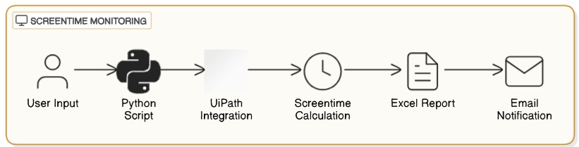
Architecture
This architecture diagram illustrates the flow of the Screentime Monitoring system. It begins with User Input, which is processed by a Python Script for monitoring activities. The script integrates with UiPath to automate the tracking process and perform Screentime Calculation. The results are compiled into an Excel Report, which is then sent to the user through an Email Notification.

Slide 8
System Requirements
Hardware:
Processor: Dual-Core or higher (Intel i3/AMD equivalent).
RAM: 4 GB (8 GB recommended).
Storage: 100 GB free space (SSD preferred).
Network: Stable internet connection (5 Mbps or higher).
Software:
OS: Windows 10/11, macOS, or Linux.
Tools: UiPath Studio, UiPath Robot, UiPath Orchestrator.
Data Source: Excel for schedules

Slide 9
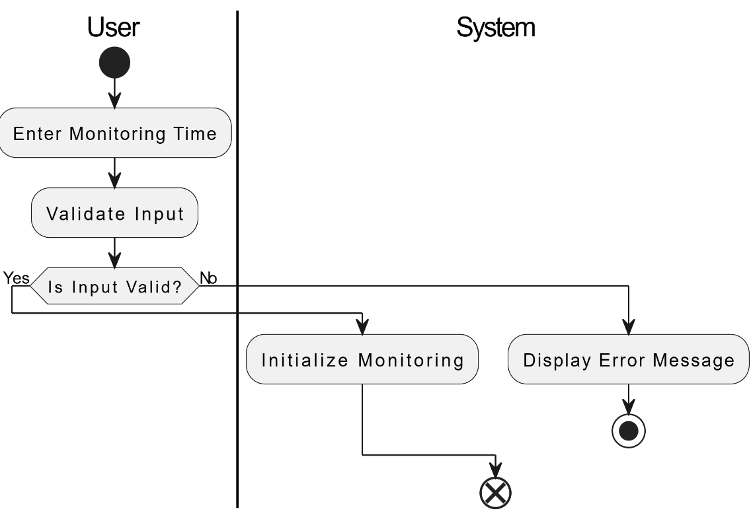
Functional Description
Module 1: User Input and Process Initialization
The user inputs the desired screentime duration.
The system initiates the process based on the provided input, confirming the parameters of the monitoring session.
The bot then integrates with Python scripting to track active application usage.
Activity Diagram-Module 1 :

Slide 10
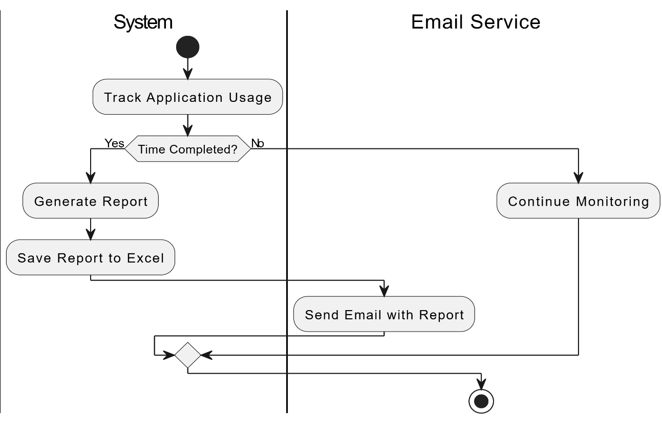
Functional Description
Module 2: Screentime Monitoring and Report Generation
The bot then integrates with Python scripting to track active application usage.
The bot continuously monitors the user's application usage in real-time during the set period.
Upon completion of the time, the bot generates a comprehensive report detailing the screentime data, which is then formatted and stored in an Excel file.
Activity Diagram-Module 2:

Slide 11
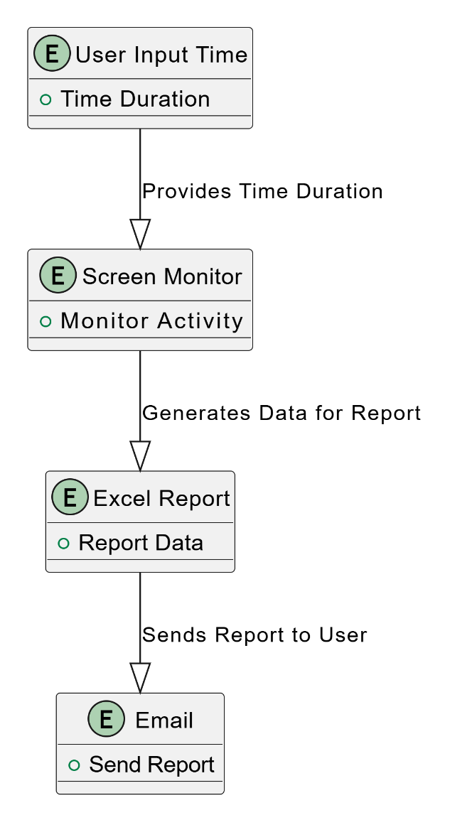
Table Design

Slide 12
Process Design
The bot starts by asking the user for the task name and the estimated duration for tracking screen time.
The bot verifies the provided information and prepares to begin the tracking process.
The bot monitors active applications on the laptop in real-time.
The bot records the start time and end time for each application the user interacts with.
The bot tracks the total screen time spent on each application.
Once the task duration is completed, the bot consolidates the application usage data.
The bot calculates the total screen time for each application and logs it in a structured format.
The bot automatically generates a detailed Excel report.
The report includes:
Application Names
Total Screen Time for each application
The bot prepares to send the generated Excel report via email.
The bot integrates with email services (e.g., Gmail, Outlook) and sends the report to the user's predefined email address for convenient access.

Slide 13
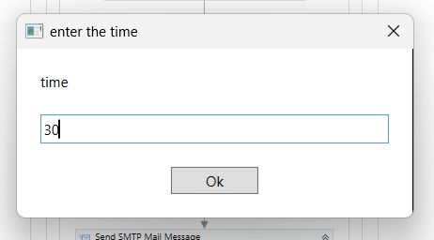
Implementation

Slide 14
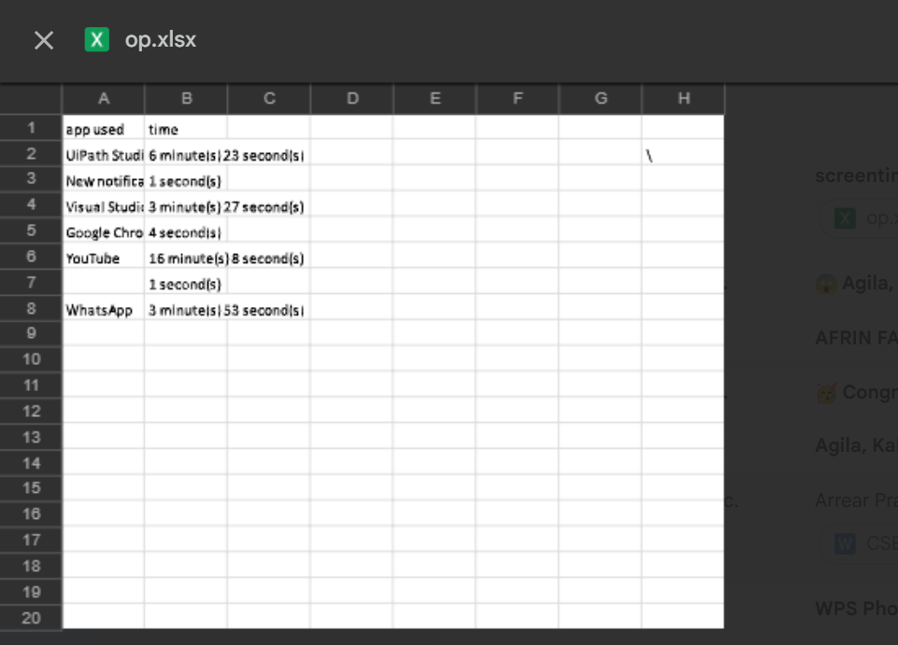
Implementation

Slide 15
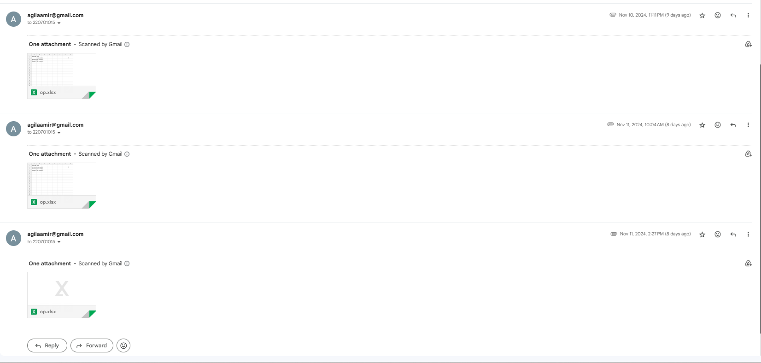
Implementation

Slide 16
Testing
Test Description: Verify if screen time usage of each application is correctly monitored and recorded in the Excel report.
Input: Task name: Time: "30 minutes. The user starts the task, and the bot monitors screen time usage for the duration of the task.
Expected Output: The Excel file should contain the Application used and total screen time usage for each application used during the 30-minute task. The generated report should be sent to the user's predefined email address.
Actual Output: The Excel file was generated with accurate details, including the task name, and total screen time usage for each application within the 30-minute task. The report was successfully sent to the user's email address.

Slide 17
Conclusions
The Intelligent Screentime Monitoring Bot offers an innovative solution for users to effectively track and manage their screen usage by combining UiPath automation with Python scripting. It enables real-time monitoring of application usage, generating detailed reports and providing users with valuable insights to enhance productivity. The bot's user-friendly design, featuring input duration, automated data tracking, and report generation, ensures a seamless experience. Furthermore, its automated email feature simplifies access to the generated reports, making it more convenient for users. By reducing manual tasks and improving efficiency, the bot empowers users to better manage their digital habits, setting the foundation for future enhancements like advanced analytics and personalized recommendations to further optimize screen time management.

Slide 18
Future Enhancement
Integrate machine learning or AI to analyze the user’s behavior and provide personalized suggestions on how to optimize their work or study habits. This could include recommending optimal work-rest intervals based on usage patterns.
Provide long-term insights such as weekly, monthly, and yearly trends of application usage. This can help users recognize not only daily patterns but also seasonal or habitual changes, aiding in more long-term habit improvement.

Slide 19
References
UiPath Documentation
Mukhametzyanov, "Screen Time and Health of Children and Adolescents," 2021 1st International Conference on Technology Enhanced Learning in Higher Education (TELE), Lipetsk, Russia, 2021, pp. 252-255, doi: 10.1109/TELE52840.2021.9482573.

Slide 20
Thank You

